Slide 1



Elevate your
video meeting experience
Elevate your
video meeting experience
Product Presentation
www.inogeni.com sales@inogeni.com

Slide 2
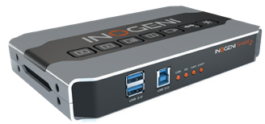


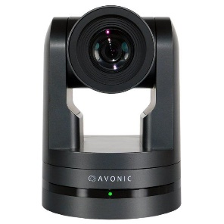


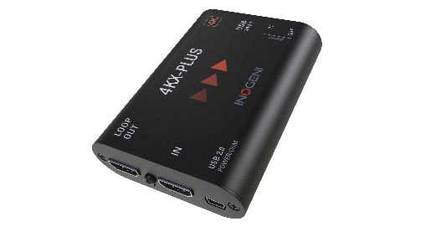
Elevate your video meeting experience
PRO AV DEVICES
MIX / SWITCH / CONVERT

Slide 3
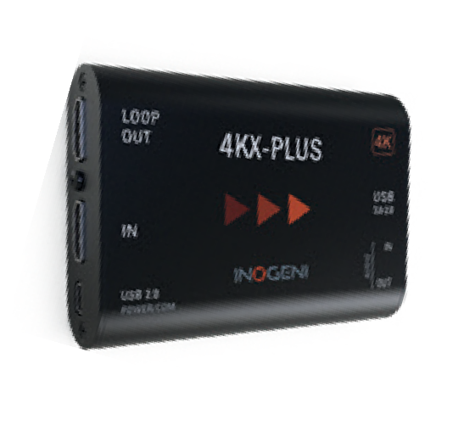
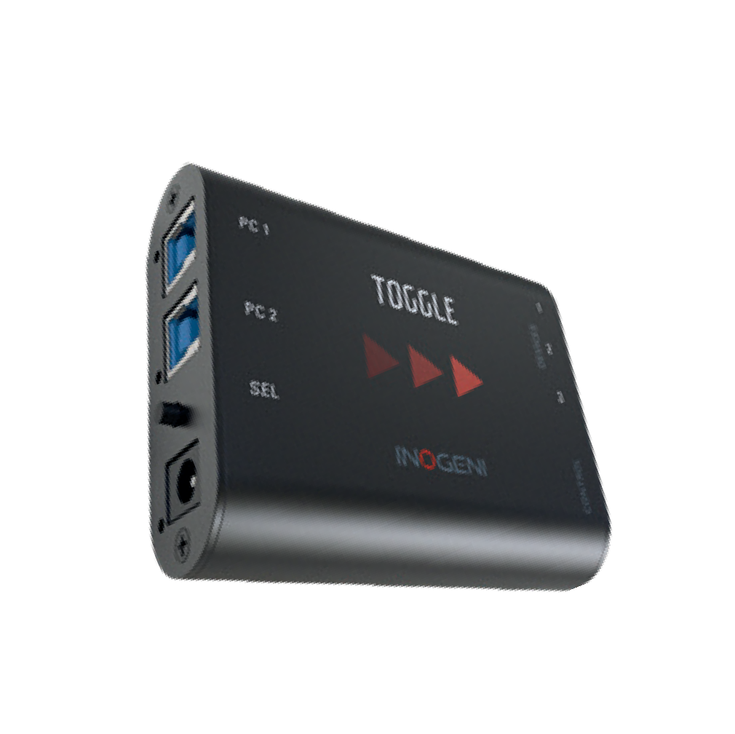
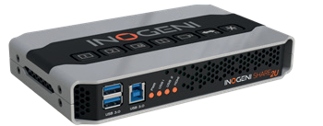
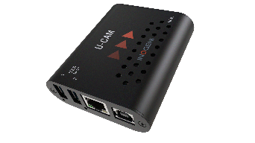
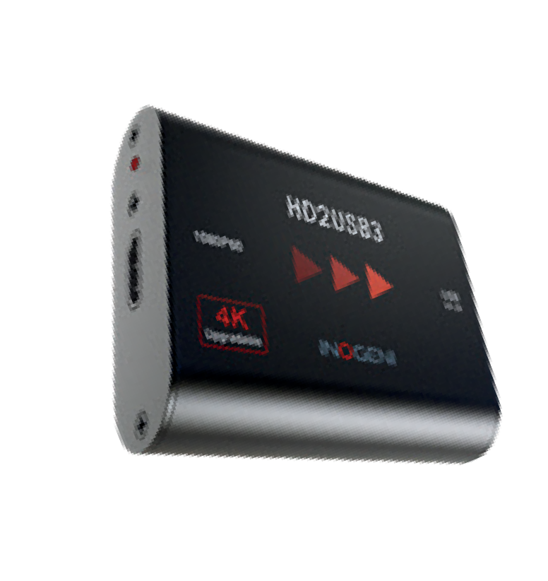
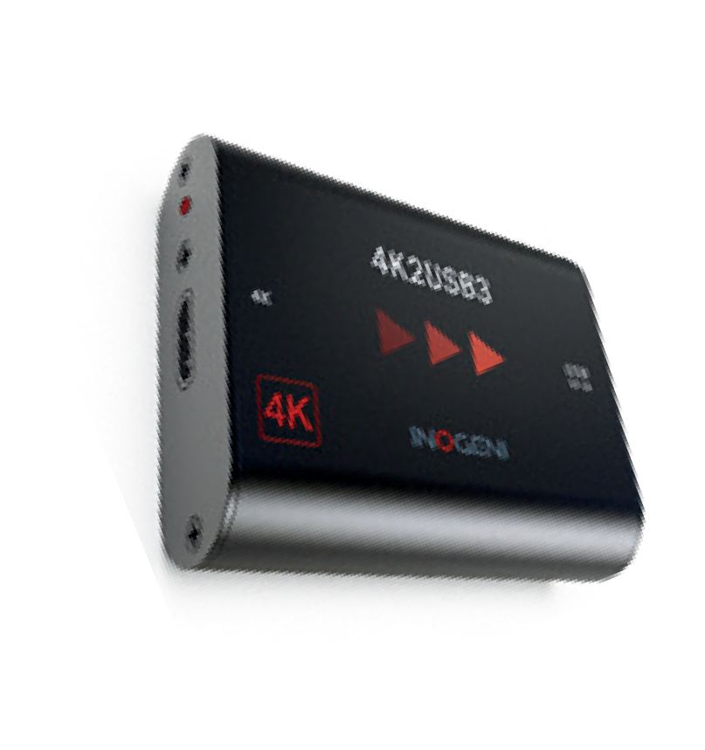
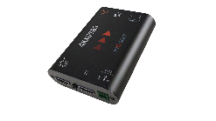
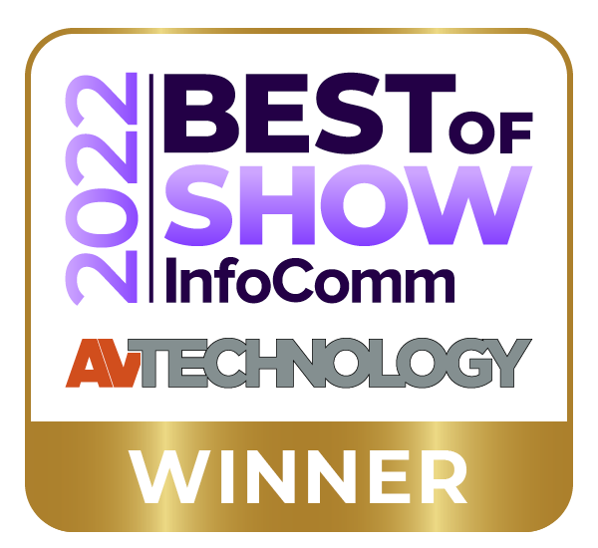
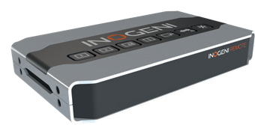
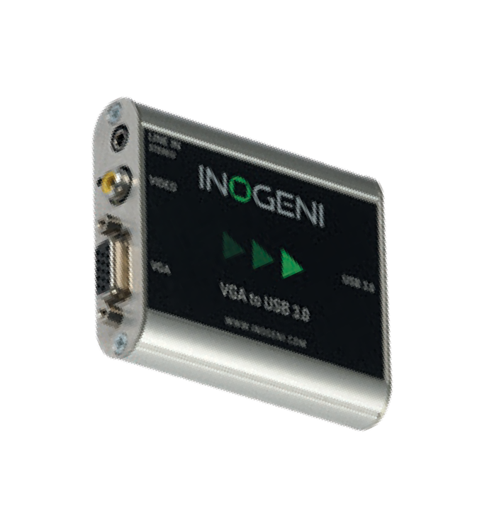
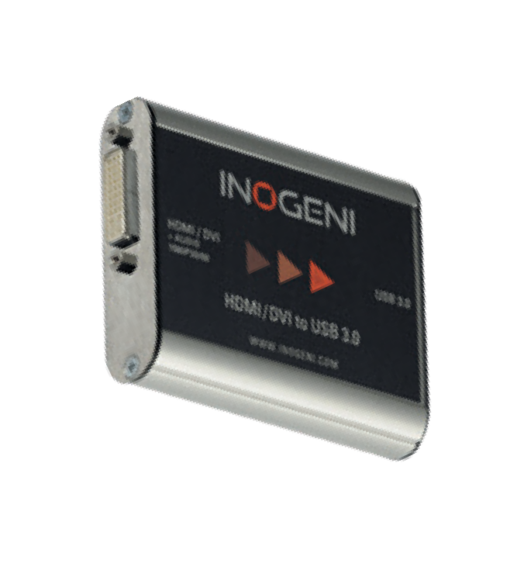
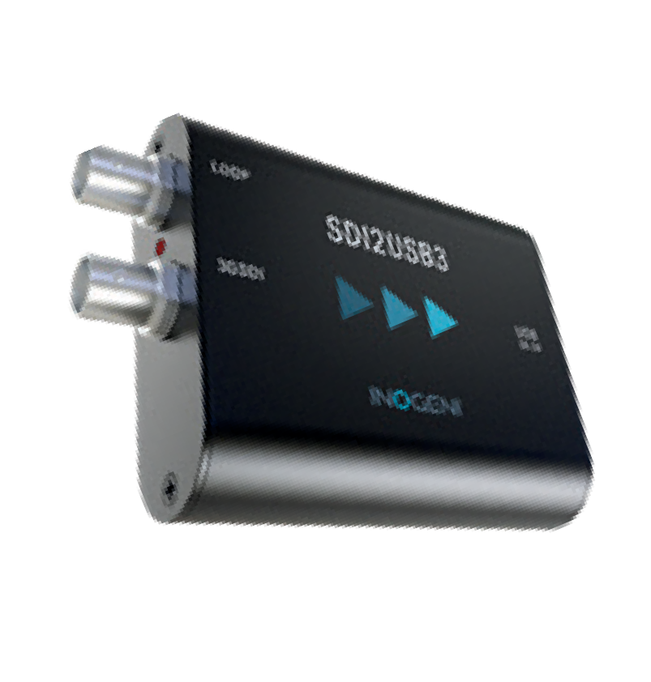



PRO AV DEVICES
MIX / SWITCH / CONVERT
MIXER/SELECTOR
for USB/HDMI CAMERAS
SHARE2, SHARE2U, CAM-300
Picture-in-Picture
RS-232 & LAN Control
VIDEO CAPTURE to USB 3.0
HDMI, 4K with HDMI loop
SDI, DVI, VGA
USB 2.0 compatible
BYOM SWITCHER TOGGLE
Switch between two PC hosts
3 USB devices
RS-232 & GPI Control
CONVERTER
USB CAMERA to HDMI
U-CAM
USB camera source
HDMI output
RS-232 & LAN control
NEW!
Discover Product Demo Videos on YouTube

Slide 4
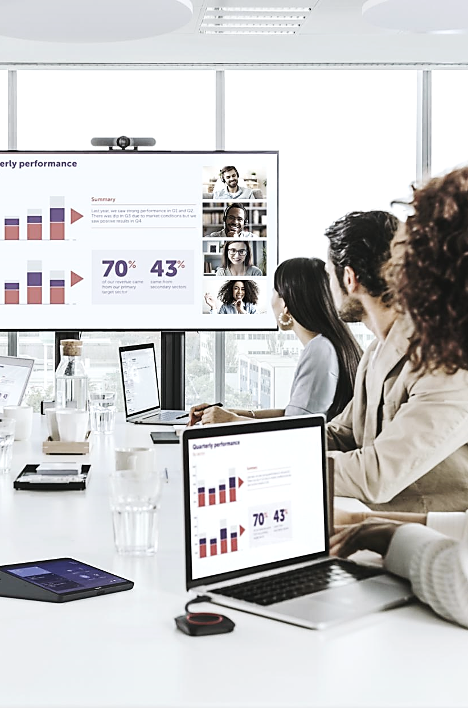

15 Years of Mastering
AV technology
Premium AV conferencing experiences
  Highly stable signal
  Advanced video processing to
    USB 3.0 1080p 4K
    USB 2.0 1080p MJPEG
Compatible by design
  Partnerships with Cisco Webex, Barco, Huddly, Crestron, Jabra
  Teams and & Zoom friendly
Peace of mind installation
  Plug & Go - No driver required
  Responsive support team
  High quality/security - manufactured in Canada

Slide 5












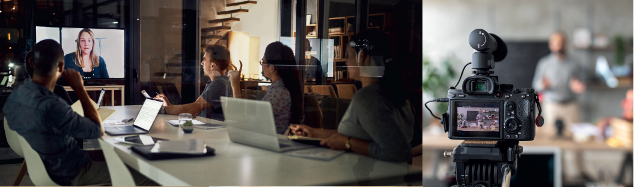
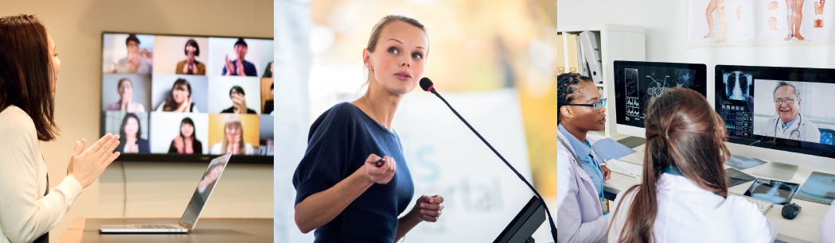
PRO AV
Market Applications
Video conferencing, webcasts
Tele-health and medical equipment
Web
training
HyFlex classrooms
Lecture capture
Notes:
INOGENI’s engineering team leverages more than 15 years of AV electronic experience to offer a comprehensive product portfolio and technology
solutions that facilitate and simplify conference room connections. Our goal is to create highly stable, seamless and premium AV conferencing experiences.
INOVATIVE Market-oriented & problems-solving company:
Highly qualified experience in audiovisual design & support team

Slide 6
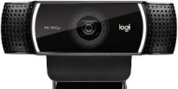
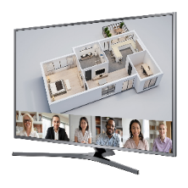
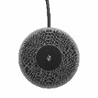

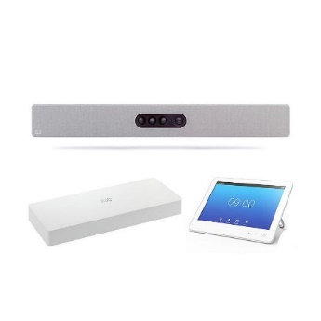



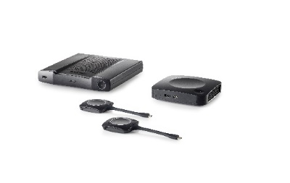


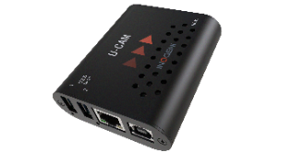
















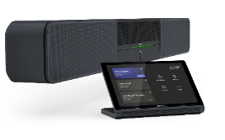



INTEROPERABILITY & PARTNERSHIPS
Audio & Video
Compatible by Design
PC & Room Systems
Streaming & Display

Slide 7
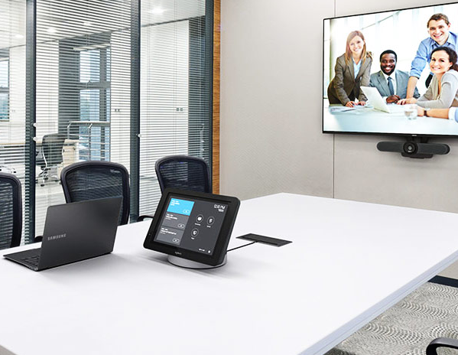
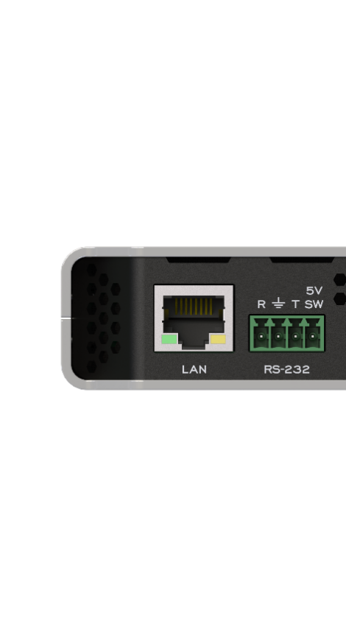
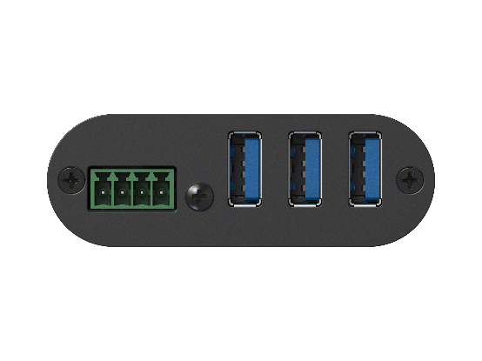
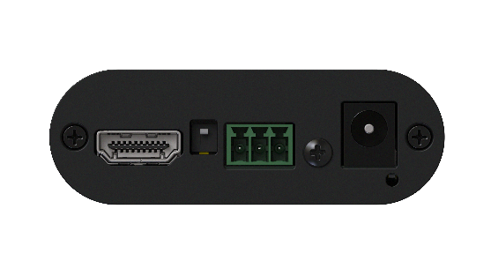
Control Options
Simple integration
with your control system
Crestron Macros
RS-232
LAN HTTP and TCP
USB HOST Interface
API engineering available
T
R
T
R
SW
RS-232
RS-232

Slide 8
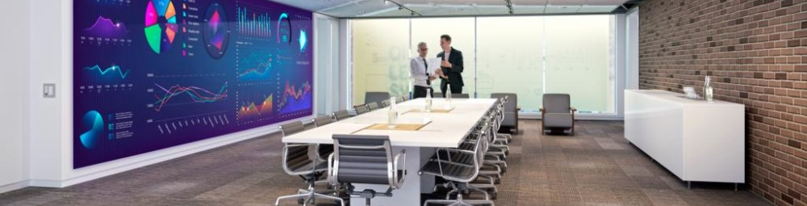
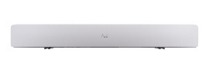
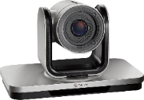

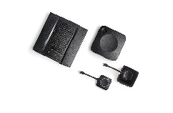
USB 3.0 Cable Extension Problems!
Difficult and expensive to extend past 15 ft. \ 5m.
USB 2.0
USB 2.0
TX
RX
USB 2.0 Extender
MJPEG Solution on USB 2.0
All INOGENI products support USB 3.0 and include high-quality MJPEG encoder on USB 2.0
Minor loss of quality over USB 3.0
Affordable and reliable to extend +100 ft. \ 33 m.

Slide 9
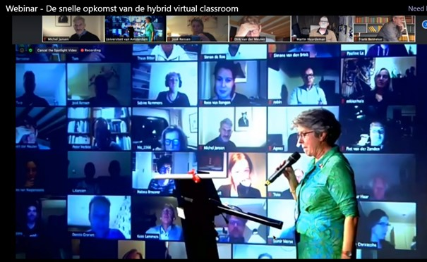
Meeting Equity in a Hybrid Environment
CLASSROOM CHALLENGES
Mix of video/audio quality
Low engagement
Low interaction
Difficult to carry out interactive session with people inside and outside of the classroom

Slide 10
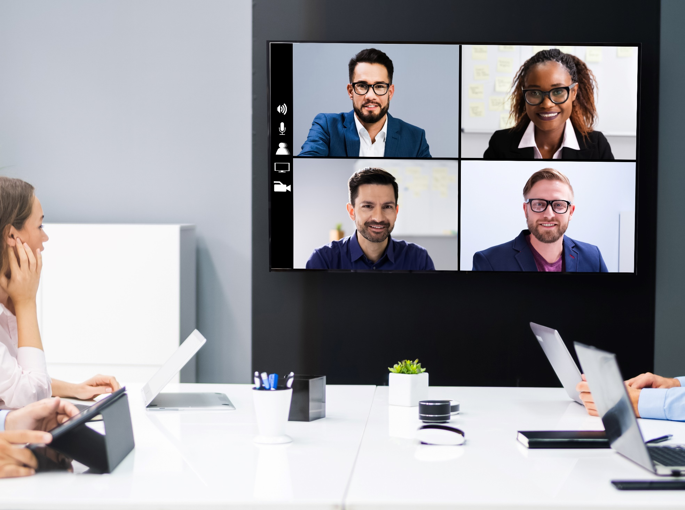
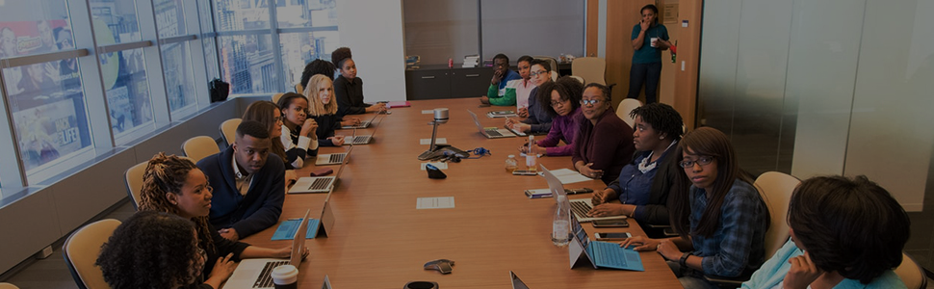
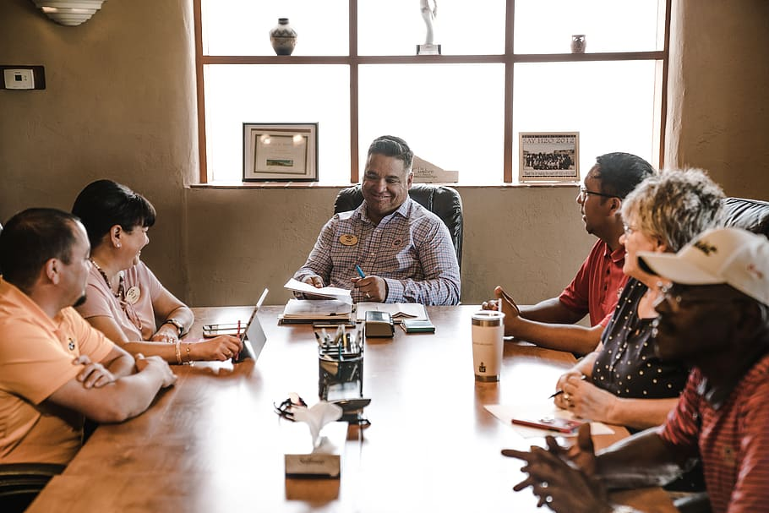
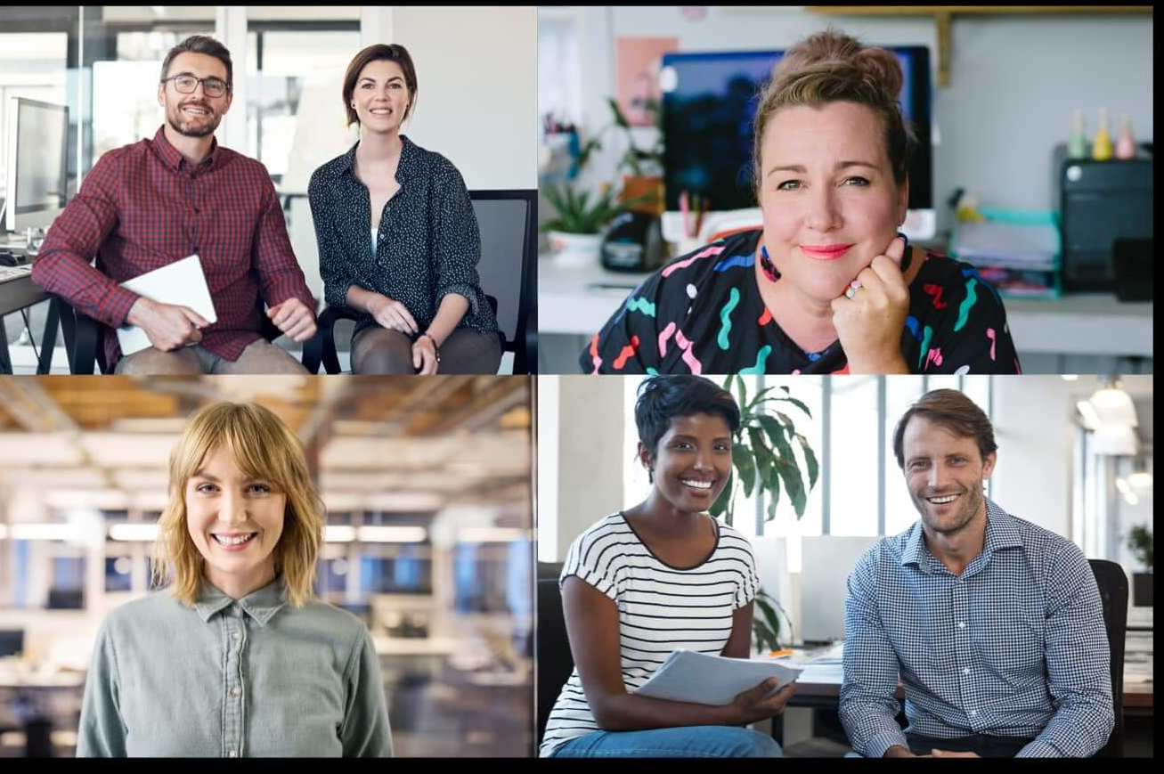
Meeting Equity in a Hybrid Environment
MEETING CHALLENGES
Poor video quality
Small faces and difficult to sense body language
Feel far away
Bad sound quality
Difficult to host real collaborative meeting

Slide 11
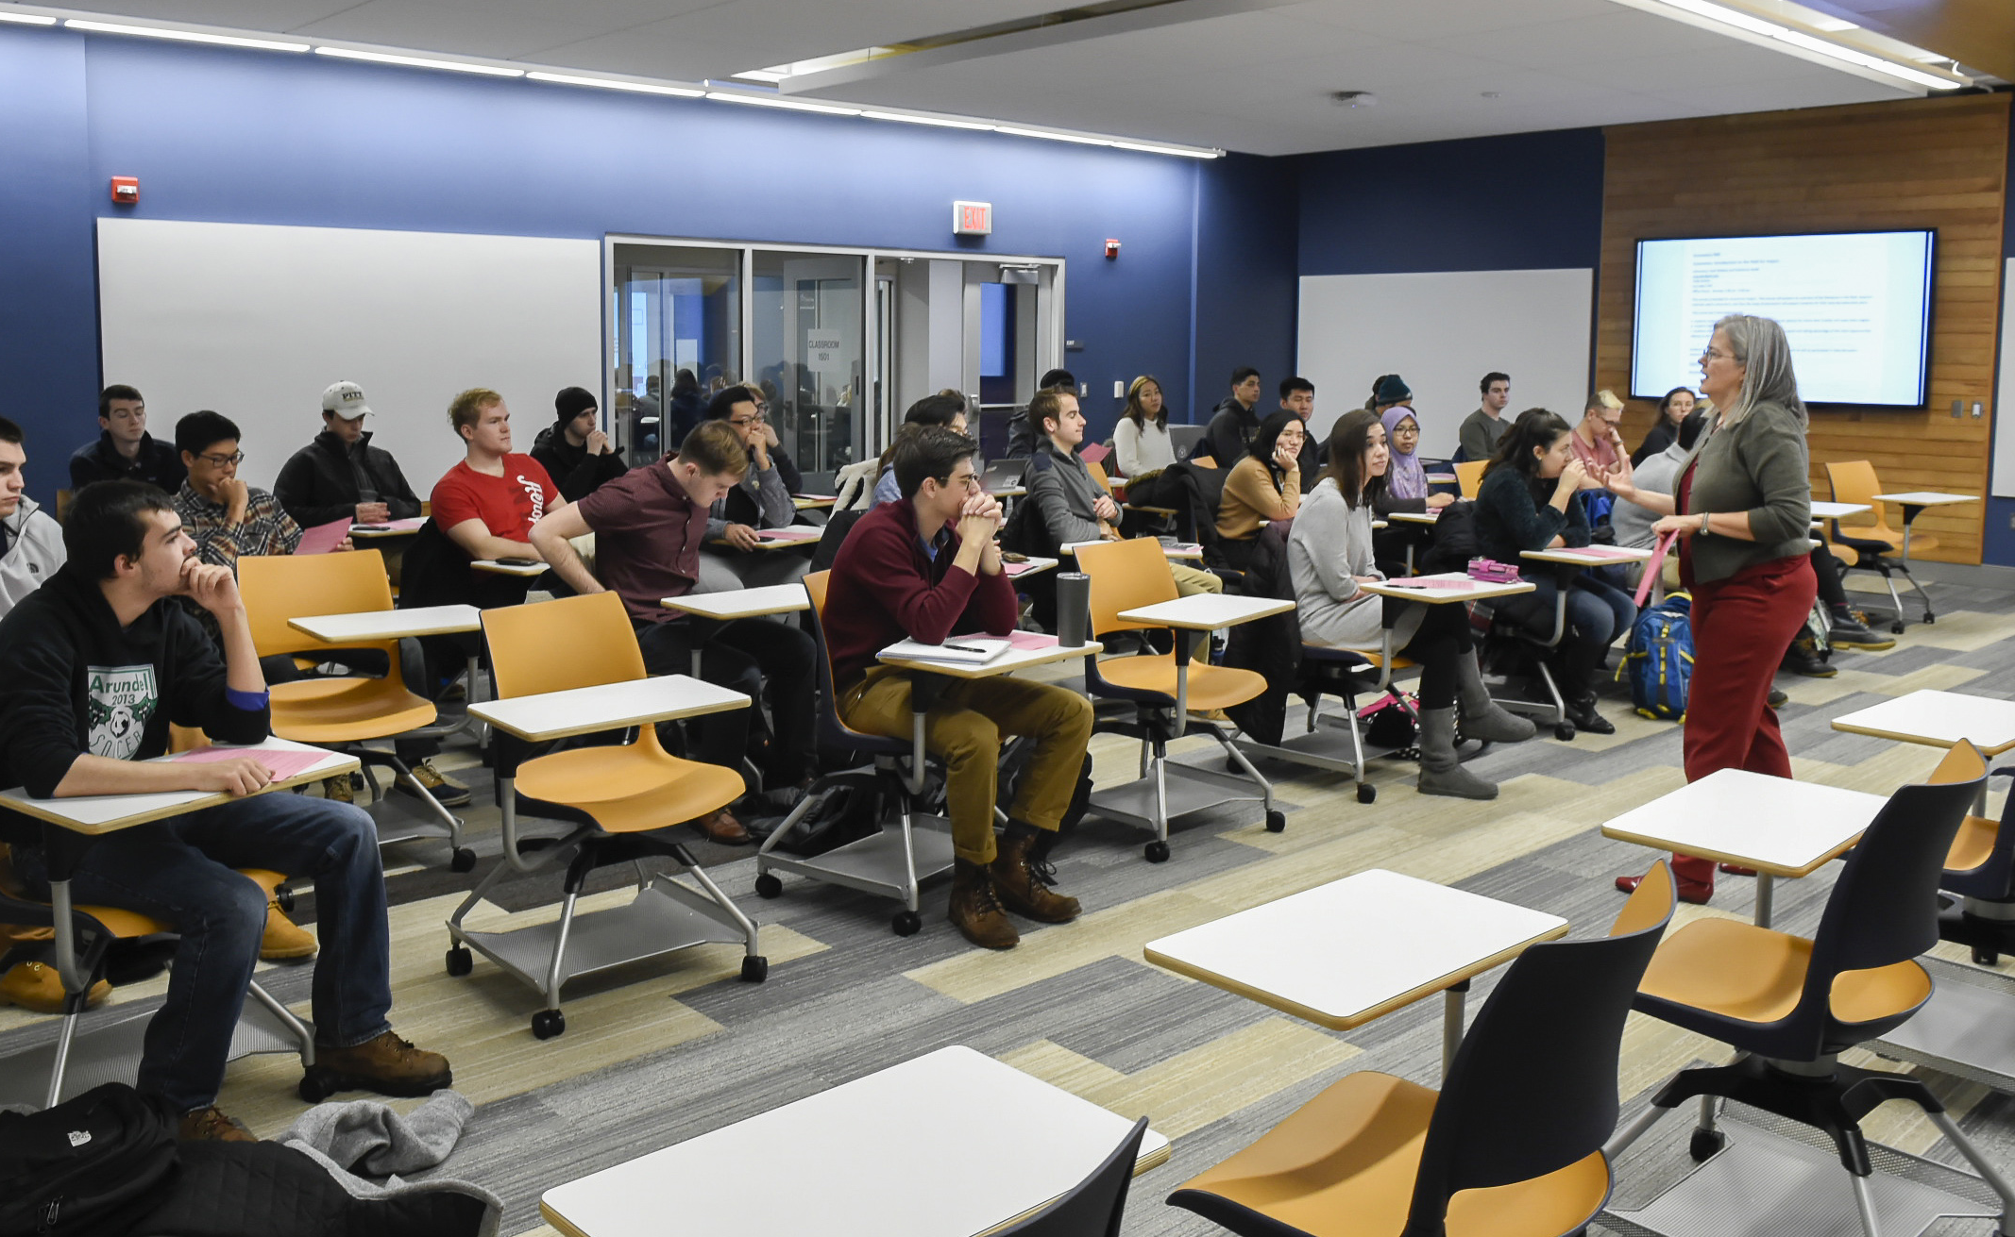

Meeting Equity in a Hybrid Environment
HOW TO FOSTER ENGAGEMENT
View facial expressions
Understand visual details
Hear voices adequately
Better cameras are not enough!

Slide 12
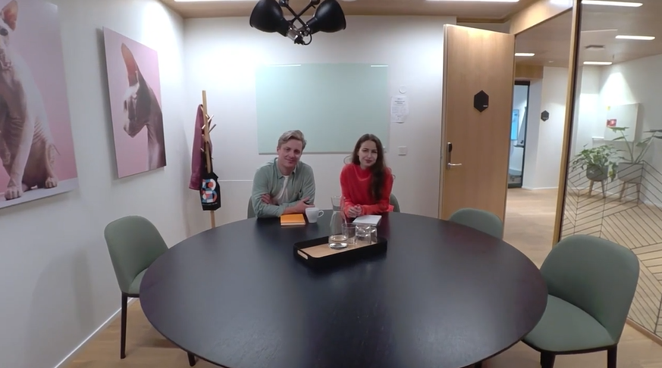
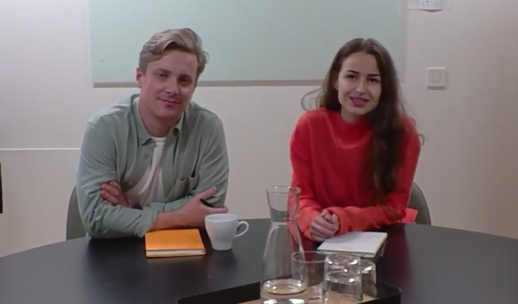



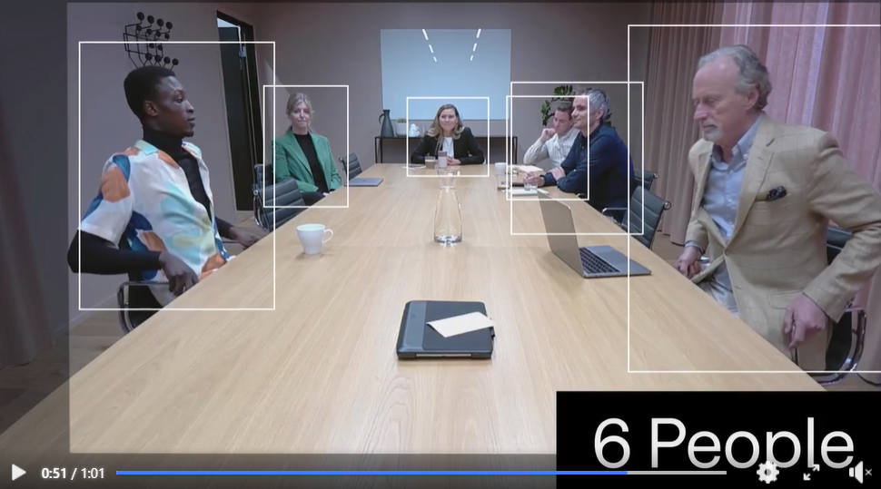


Meeting Equity in a Hybrid Environment
AI + SMART CAMERAS
Face framing
Auto tracking
Lighting balance
Voice tracking
Huddly IQ + ‘’Famous framing + Portrait lighting + Insights Analytics API’’
VADDIO

Slide 13

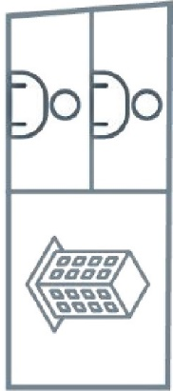
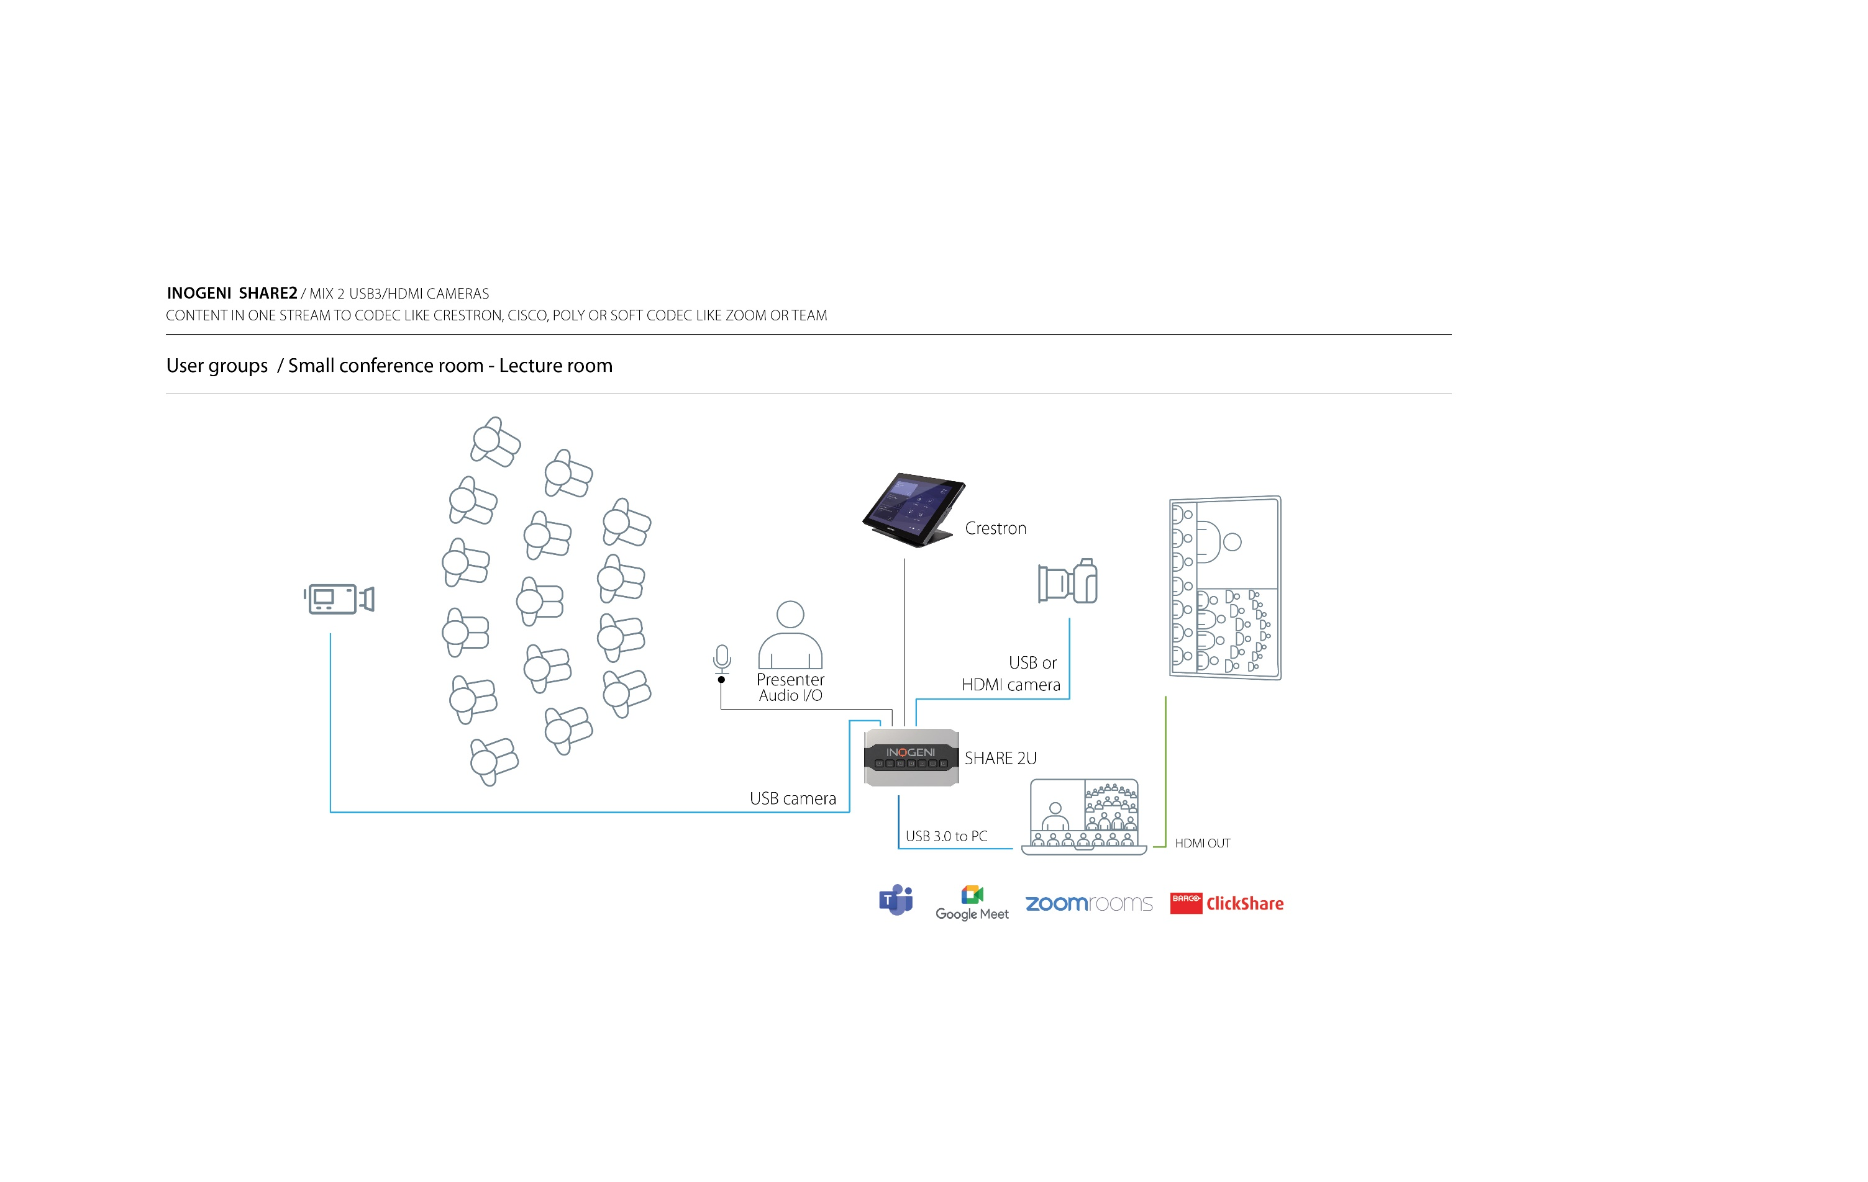
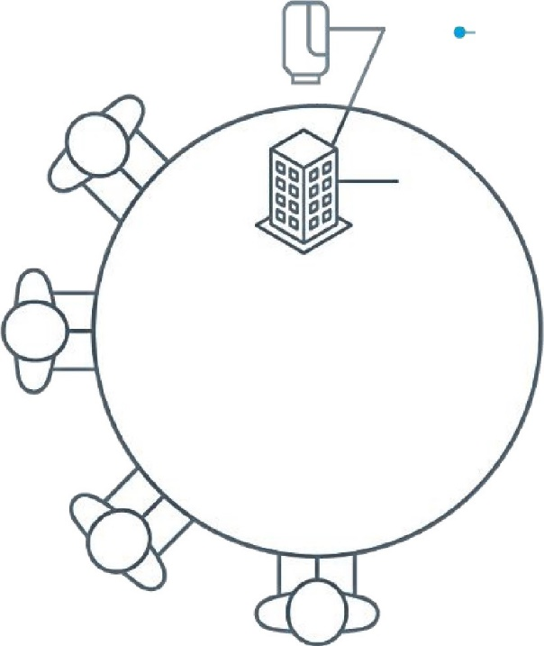
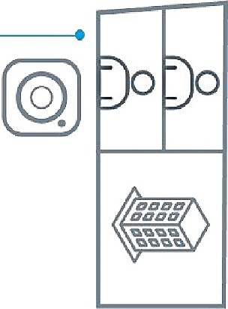
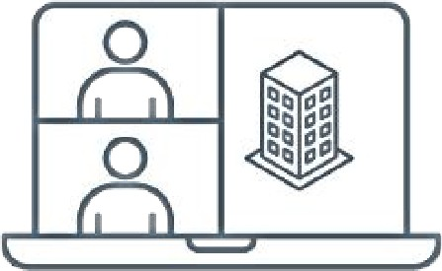
Multiple Camera Benefits
Multiple point of view
Presentor view
Audience view
Object of interest views
White board
Better user experience
  More Engaging meeting
  Meeting equity
  More dynamic meeting

Slide 14
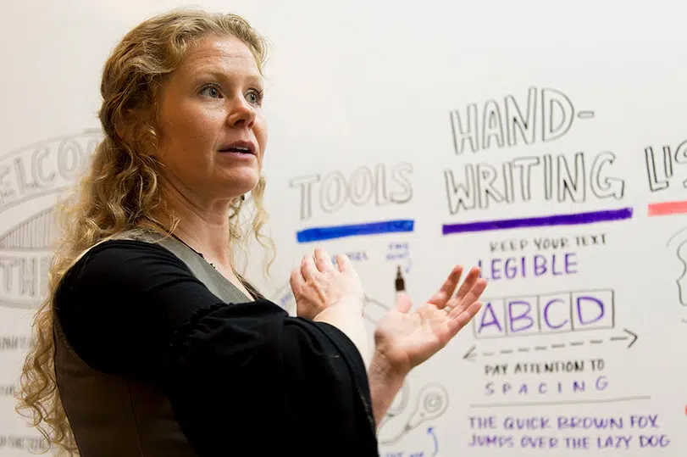
Meeting Equity for All Participants
What are the rules?
High-quality video and sound
AI cam to frame those who speak
Multiple-cameras to capture details or whiteboard
Easy mixer/switcher/selector to keep the flow of the conversation and interaction

Slide 15
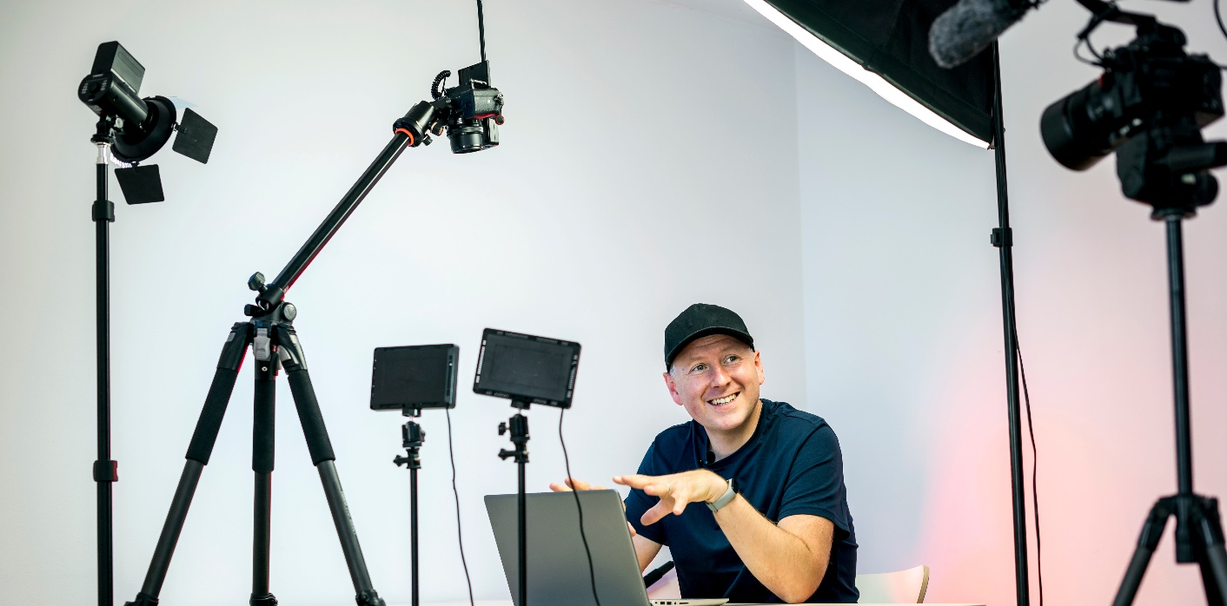
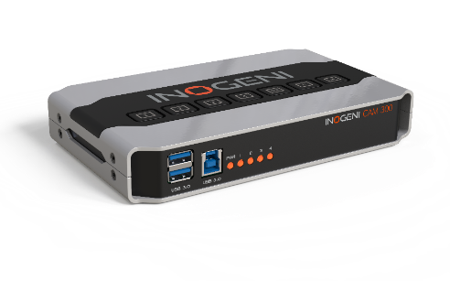
Easy and versatile video camera mixers to
USB 3.0 for advanced HyFlex classrooms or meeting collaborations
SHARE2
2 HDMI CAMERAS MIXER to USB 3.0
SHARE2U
1 USB + 1 USB or HDMI CAMERA MIXER to USB
CAM-300
2 USB & 2 HDMI CAMERA SELECTOR to USB 3.0
REMOTE
CONTROL KEYPAD
of SHARE2 / 2U & CAM 300

Slide 16


SHARE2
2 HDMI CAMERA MIXER to USB 3.0

Slide 17










SHARE2
2 HDMI camera mixer
Easy Plug&Go mixer
for Picture-in-Picture
in one video flow
2 HDMI input
Audio I/O
USB 3.0 output
LAN/ RS-232 control options
Compatible by design with all apps
2 HDMI CAM
Mixer control
LAN, RS-232
USB 3.0

Slide 18


Amaze your audience with a 2 camera mixer
SHARE2
2 HDMI camera mixer

Slide 19


Slide 20


SHARE2U
1 USB + 1 USB or HDMI CAMERA MIXER to USB 3.0

Slide 21




SHARE2U
2 USB 2.0 and 1 HDMI camera mixer
Easy Plug&Go mixer
for Picture-in-Picture
in one video flow
2 USB 2.0 and 1 HDMI
Audio I/O
USB 3.0 output
LAN/ RS-232 control options
Compatible by design with all apps
Mixer control
LAN, RS-232
USB CAM
USB/HDMI CAM
USB 3.0
Notes:
Capture and mix simultaneously 2x USB 2.0 camera with audio into one 1080p60 USB 3.0 signal; (input 2 can also be HDMI 1080p30 source such as PC content)
Support MJPEG and H.264 video over USB 2.0 (most USB 3.0 cameras have a USB 2.0 mode)
HDMI loop output for preview
Integrated mixer give you many display options
PTZ control over USB 3.0
Two USB 3.0 front expansion ports can be used for any USB accessories
Control interface via USB, LAN and RS-232 including Crestron and AMX modules

Slide 22

Energize your Videoconference and Classroom Presentations
Energize your videoconference and classroom presentations
SHARE2U
2 USB 2.0 and 1 HDMI camera mixer

Slide 23

INOGENI SHARE2U
HOW TO CONNECT YOUR DEVICES / AUTOMATICALLY CONNECT WITH ALL APPS WITHOUT DRIVERS
User groups / Collaborative meetings

Slide 24

INOGENI SHARE2U
HUDDLE MEETING ROOM/ MIX 2 USB3 / HDMI CAMERAS OR CONTENT IN ONE STREAM
User groups / Collaborative meeting room
Room camera

Slide 25
INOGENI SHARE2U

Slide 26



Saint-Xavier University
Chicago, IL
Case Study
The challenge was meeting equity and difficulties in creating free interaction between the audience inside of the classroom and outside of the classroom.
Videoconference objectives acheived:
Meeting equity ( Students inside / outside)
Free collaboration and interaction
Super easy to switch and mix cameras
Easy to use by professor even for the first time

Slide 27


Saint-Xavier University
Chicago, IL
Pilot project with the nursing department to standardize all classrooms on the campus
74 Installations (2021-2022)
1x INOGENI SHARE2U
2x AVER Cam 520 PRO 2 / USB 3.0
1x Dedicated room PC
1x Microphone

Slide 28


Multi camera selector
HyFlex Classrooms or collaborative meetings
CAM300
2 USB + 2 HDMI CAMERA SELECTOR to USB 3.0

Slide 29



CAM 300
2 USB 2.0 and 2 HDMI camera selector
USB CAM
Easy Plug&Go
camera selector
Seamless switch between 2x USB and 2x HDMI sources
Simultaneous HDMI & USB 3.0 output
USB/HDMI embedded audio
LAN/ RS-232 control options
Compatible by design with all apps
USB CAM
Mixer Control
LAN, RS-232
HDMI CAM
HDMI CAM
USB 3.0
Notes:
Capture and mix simultaneously 2x USB 2.0 camera with audio into one 1080p60 USB 3.0 signal; (input 2 can also be HDMI 1080p30 source such as PC content)
Support MJPEG and H.264 video over USB 2.0 (most USB 3.0 cameras have a USB 2.0 mode)
HDMI loop output for preview
Integrated mixer give you many display options
PTZ control over USB 3.0
Two USB 3.0 front expansion ports can be used for any USB accessories
Control interface via USB, LAN and RS-232 including Crestron and AMX modules

Slide 30

INOGENI CAM300
4 VIDEO SOURCES SELECTOR
User groups / Hyflex Classroom or Collaborative meeting room / Automatically connect with all apps without drivers
Elevate your
video meeting
experience
Easy Push-Button

Slide 31

INOGENI CAM300

Slide 32

REMOTE
CONTROL KEYPAD
of SHARE2 / 2U & CAM 300

Slide 33
REMOTE
Remote control of SHARE2, SHARE2U and CAM 300
SIMPLE CONNECTION WITH cat5 CABLE
SHARE2
SHARE2U
CAM-300

Slide 34

REMOTE
Remote control of SHARE2, SHARE2U and CAM 300

Slide 35


TOGGLE
USB BYOM SWITCHER
3 USB devices
& Host Switch

Slide 36


How do you use your
ZoomRoom devices
in a Teams meeting?
?
USB MICROPHONE

Slide 37



Réduire
RS-232 Control
3 USB 3.0/2,0
USB Host Switch
Auto-switch
Controllable by RS-232 & GPI

Slide 38


Slide 39

USB 3.0 Camera to HDMI converter

Slide 40

U-CAM
USB camera + USB microphone to HDMI

Slide 41


Slide 42


Slide 43

4KX-PLUS
HDMI to USB 3.0 capture device
Enabling BYOM on Cisco Webex Room Series

Slide 44




















Webex Devices Portfolio
4KX-PLUS
Unlocking BYOM in a Webex Environment
Desk Series
Room Series
USB pass-through native
Webex Desk Pro
Webex Room 55
Webex Room 55D
Webex Room 70S G2
Webex Room 70D G2
Webex Room Panorama
USB pass-through native
USB pass-through native
Webex Desk
Webex Room USB
Webex Room Mini
Webex Room Kit
Webex Room Kit Plus
Webex Room Kit Pro
Board Series
Webex Desk Mini
Webex Desk Hub
Webex Board 55
Webex Board 70
Webex Board 85
Webex Board Pro 55
Webex Board Pro 75
Notes:
But the older systems do not have this function.
This is where Inogeni comes into play

Slide 45

4KX-PLUS
Convert Ultra HD to USB 3.0 with HDMI loop analog audio, and external power
If no Laptop
Notes:
This device is powered by USB
(It could be powered by the laptop)

Slide 46


4KX-PLUS
HDMI to USB 3.0 capture device
Enabling BYOM on Cisco Webex Room Series
The most cost-effective & user-friendly interoperability solution

Slide 47

4KX-PLUS
HDMI to USB 3.0 capture device
Enabling BYOM on Cisco Webex Room Series
Equipment (cameras & microphones)
Cisco Webex Room Kit Plus application
Macro and native
Webex Room Kit
Webex Room Kit Plus
Webex Room Kit Pro
Webex Room 55
Webex Room 70
Webex Room Panorama
Macro only
Cisco MX700
Cisco MX800
Cisco SX80
4KX-PLUS with Webex devices support (connected to multiple display)
4K2USB3 with Webex devices support (connected to only one display)
Optional adaptor for USB-C Laptop Port.

Slide 48





4KX-PLUS
Enable USB mode on Cisco Webex Touch 10
Enable USB mode
Short Demo by Cisco
https://youtu.be/42V0Loq0vdU
Detailed Demo by cisco
https://youtu.be/R5Hde9Zvbvw

Slide 49

Compatible USB Peripheral with Webex Systems

Slide 50













4KX-PLUS
HDMI to USB 3.0 capture device
Enabling BYOM on Cisco Webex Room Series
4KX-PLUS
Now Available!
INOGENI
4KX-PLUS
CISCO CODEC PLUS
4K CAMERA
3.5 MM AUDIO CABLE
MIC 1 - 3.5 MM
-
IN
VIDEO HDMI
HDMI - VIDEO LOOP
MIC 2 - 3.5 MM
3.5 MM - LINE OUT
LINE - 3.5 MM
3.5MM - HEADPHONES
MIC 3 - 3.5 MM
-
VISCA - PHX
-
1080P VID 1 - HDMI
HDMI - 4K VIDEO 2
USB 3.0 - USB C
EXTERNAL POWER
4K VID 2 - HDMI
HDMI - 4K VIDEO 1
IN
OUT
SCREENS
4K VID 3 - HDMI
-
DEVICE - USB-B
USB-A - HOST
CISCO TABLE
MICROPHONES
LINK LOCAL 1 - POE
-
LINK LOCAL 2 - ETH
ETH - LAN
IN
OUT
CISCO QUAD CAMERA
LINK-LOCAL NETWORK
LINE 3.5 MM TRS
RCA - SUBWOOFER
169.254.1.0/24
POE SWITCH
-
HDMI W/ARC - HDMI 1
-
HDMI - HDMI 2
-
USB - A - HOST
12VDC - BARREL
ETH - CAM CTRL
IN
OUT
POE INJECTOR
USB 3.0
TOUCH 10
CONFERENCE VIDEO AND AUDIO HDMI
PRECISION 60 CAMERA
COLOR KEY
HDMI
FSR Digital Ribbon Cable USB
Audio Link Local
LAN Ethernet Touch 10
LAN
Cisco Webex Room Kit Plus
and Inogeni 4KX-PLUS for
USB Passthrough Line Drawing
Drawing Reference
ENRICO CONEDERA
Senior Technical Marketing Engineer at Cisco Systems

Slide 51



Converter
USB 3.0 VIDEO CAPTURE
Multi signal converter
to USB 3.0/2.0
High-quality signal
Compatible by design
    Plug & Go with all video+cam peripherals
Ease of use & to install
  USB 2.0 compatible, easy and reliable to extend with USB 2.0 extender

Slide 52


New Enclosure Q2 2022
Converter
4KXUSB3
4K Ultra HD to USB 3.0 with HDMI loop and analog audio
Audio I/O
4K HDMI
VISCA RS-323 Control

Slide 53

Converter
4K2USB3
HDMI to USB 3.0
4K HDMI
USB 3.0/2.0 TO HOST

Slide 54

Converter
HD2USB3
HDMI to USB 3.0
4K Upgradable 1080p60 HDMI
to USB 3.0 converter
HDMI
USB 3.0/2.0 TO HOST

Slide 55

Converter
SDI2USB3
3GSDI to USB 3.0 with a loop
SDI LOOP OUT
USB 3.0/2.0 TO HOST
SDI LOOP IN

Slide 56

Converter
DVIUSB
HDMI/DVI to USB 3.0
HDMI/DVI
USB 3.0/2.0 TO HOST

Slide 57

Converter
HD2USB3

Slide 58



Q&A
Inogeni YouTube
www.inogeni.com sales@inogeni.com
support@inogeni.com

